Slide 1
PillChecker
A mobile solution for medication adherence

Slide 2
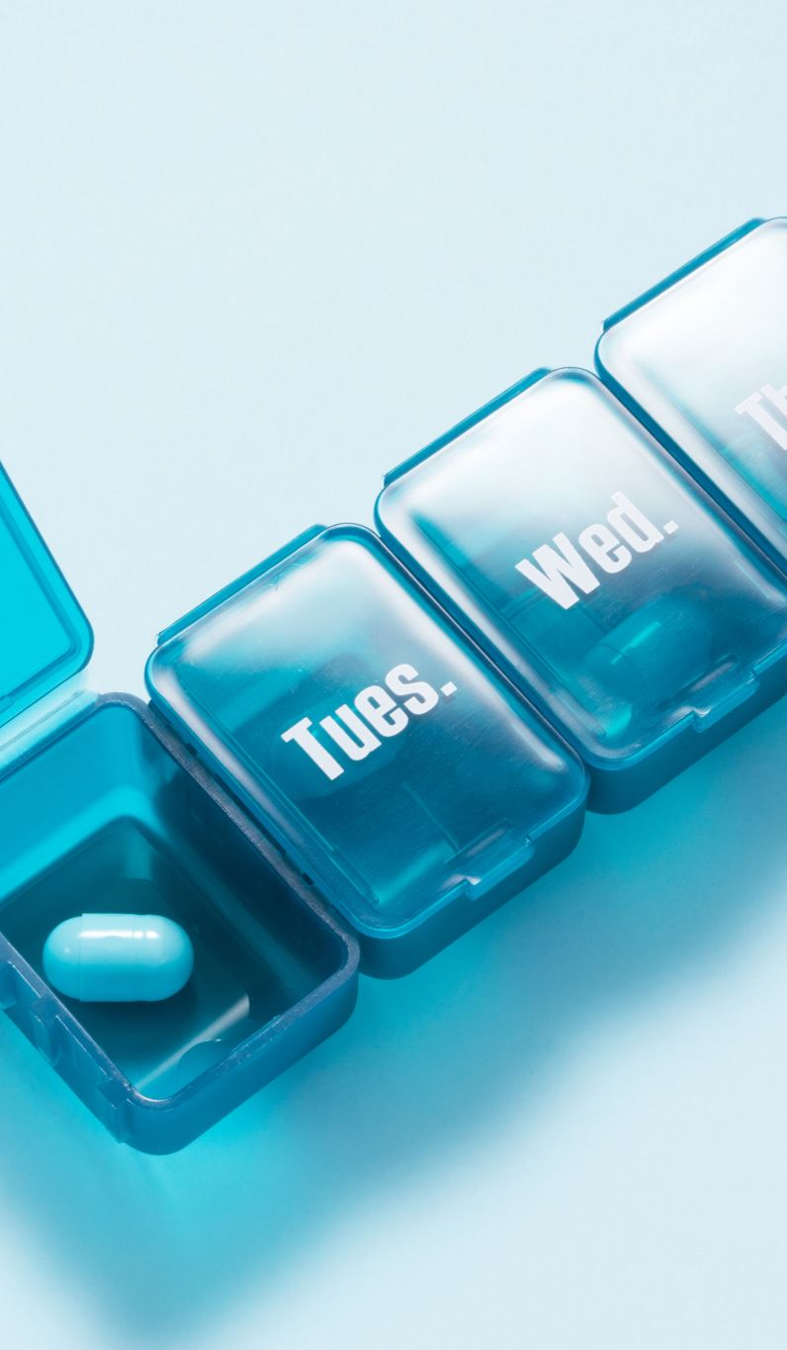
Inspiration/Explanation
Inspired by the weekly pill organizer, PillChecker streamlines confirming daily medication intake.
The goal of this app is not simply to be a “reminder” app, but more like a double check to confirm you’re keeping up with your medication.

Slide 3

Problems in Healthcare
Medication adherence challenges - Many patients forget doses, skip medications, or stop treatment early, which reduces effectiveness and worsens conditions.
Lack of personalization - Existing tools often cannot adapt to unique medication schedules or lifestyle needs.
No real-time confirmation - Traditional reminders notify users, but cannot verify if medication was actually taken.
Limited caregiver support - Family members and caregivers lack visibility into whether loved ones are sticking to their prescriptions.
Uninspiring design - Many apps or tools feel clinical or complicated, discouraging regular use.

Slide 4
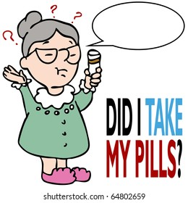
Patient’s Memory
It is likely for us to forget our responsibilities now and then, including taking our medication as prescribed
”…an estimated 50 percent of people do not take their medications as prescribed.” – Michigan Medicine 2018
This can lead to missing doses, double dosing, and/or other medical issues that can be avoided
The weekly pill box organizer is very effective in fighting this issue…but it is not made with mobile use in mind

Slide 5

Solutions
Customizable reminders – Users can set flexible reminders that match their personal medication schedules.
Refill tracking & alerts – Automatically tracks medication supply and sends timely refill reminders.
Medication interaction guidance – Provides alerts on what users can or cannot take with their prescribed meds.
Wearable sync & contextual alerts – Integrates with wearables and uses location-based reminders for convenience.
Reward/streak system – Encourages adherence through gamified progress tracking and motivational streaks.
Caregiver monitoring – Allows caregivers to remotely check medication compliance of loved ones.
Pharmacy integration – Connects with pharmacies for seamless refills and medication information.

Slide 6
App Features
Confirm daily medication – Users can log doses with a single tap and hold to verify intake.
Add/remove medications – Flexible system that supports a wide variety of medications, updated easily.
Notifications & reminders – Smart alerts to help prevent missed doses, even offline.
Supply tracking – Keeps count of remaining pills and alerts users before they run out.
Pill history + streaks – Tracks past intake and motivates users with streaks for consistency.
Side effect listing – Displays important side effects for each medication to keep users informed.

Slide 7
Tools & Tech
Languages
Dart (Flutter): A modern, object-oriented language with C-style syntax, used to build apps with Flutter.
JavaScript (React Native): A widely used web language that powers React Native for cross-platform mobile apps.
Frameworks
Flutter: Google’s framework for creating high-performance apps on iOS, Android, and more using a single codebase.
React Native: Meta’s framework for mobile apps with strong community support and rich documentation.
Backend
Firebase Cloud Firestore: A NoSQL cloud database with real-time sync and offline support for seamless data handling.
Tools
Flutter local notifications: Enables custom reminders even when offline.
Flutter widgets: Prebuilt UI components that speed up app design and ensure consistency.
Optional
OpenFDA API integration: Provides official medication details like interactions, warnings, and side effects.

Slide 8
Broad Design Ideas
An override feature if you didn’t log your medication for the day
A fun, game-like interface to encourage consistent use and medication adherence.
A timer for how long you can’t drink while on your medication

